Slide 1
Presentation Visuals

Slide 2
PowerPoint: The “Killer” App
www.slideshare.net

Slide 3
1 - Keep it Simple
Notes:
NOT Complicated
NOT busy
NO “Chart Junk”
Lots of whitespace

Slide 4
2 - Limit Bullet Points & Text
Notes:
Put Details in a handout

Slide 5
Too Much Information

Slide 6
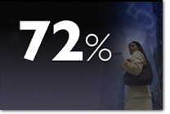
Much Better
Notes:
Slide on right is even better.

Slide 7
3 - Limit Transitions and Builds
Notes:
This means subtle, if any, animation.

Slide 8
4 - Use High-Quality Graphics
Notes:
Avoid built-in graphics – they’ve seen it before.
Photos of people help audience connect.

Slide 9
Cheesy Clipart

Slide 10
Photos are Better

Slide 11
5 - Use a Theme
Notes:
NOT PPT templates!
This presentation uses a road sign theme.

Slide 12
6 - Use Appropriate Charts

Slide 13
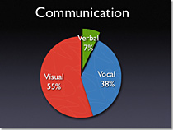
Pie Charts
Notes:
Show percentages.
Use color to contrast slices.

Slide 14
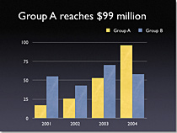
Vertical Bar Charts
Notes:
Show changes over time.
Use color to contrast bars.

Slide 15
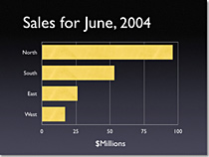
Horizonatal Bar Charts
Notes:
Compare quantities.

Slide 16
Line Charts
Notes:
Show trends.

Slide 17
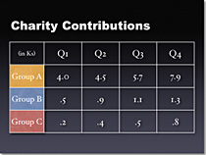
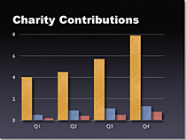
Tables
Notes:
Show side-by-side comparisons of data.
Tables lack impact.
Compare table with chart.

Slide 18
7 - Use Color Well
Notes:
Color evokes feelings.
Color is emotional.
Color can help persuade and motivate.

Slide 19
Color Spectrum
Notes:
Cool – blue & green.
Best for backgrounds (recede away).
Warm – orange & red.
Best for foregrounds (come at you).

Slide 20
Use a Dark Backgound if Lights are Low
Notes:
Easier on the eyes.

Slide 21
Use a Light Backgound if Lights are Bright
Notes:
Bright rooms wash out light text on a dark background.

Slide 22
8 – Choose Fonts Well
Notes:
Use the same font throughout presentation.
San serif fonts are usually best.
Use only one type of highlighting, e.g. BOLD.

Slide 23
9 – Use Video and Audio
Notes:
If appropriate!
Changes the pace.
Video promotes active cognitive processing.
Avoid cheesy sound effects!

Slide 25
10 - Chunk your Information
Notes:
Small chunks increase comprehension.
Create a logical flow.

Slide 26
1 – Keep it Simple
2 – Limit Bullet points & Text
3 – Limit Animations
4 – Use High quality Graphics
5 – Use a Theme
6 – Use Appropriate Charts
7 – Use Color Well
8 – Use Fonts Well
9 – Use Video & Audio
10 – Chunk Information
Notes:
Not a good slide.
What would make it better?

